Slide 1
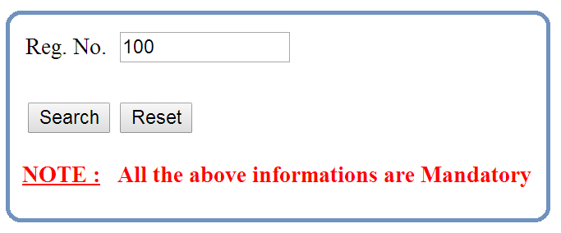

Slide 2
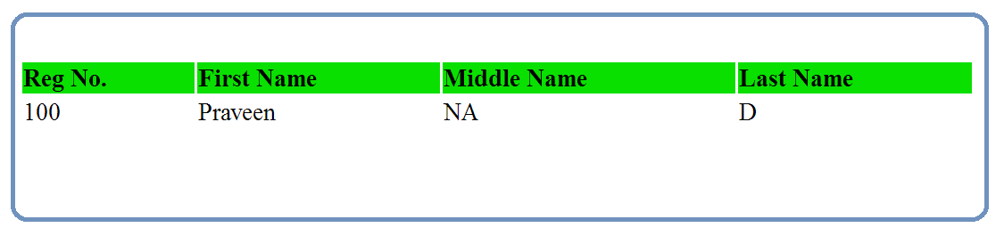
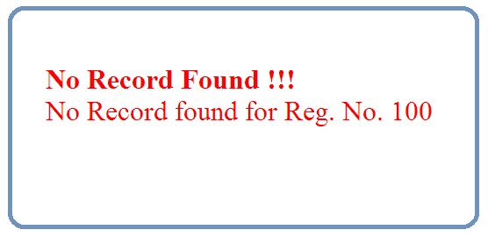

Slide 3
Servlet
JDBC
Driver
DB
Get the Reg. No. from Browser
Interact with DB using JDBC (Step 1 to 5) & get the corresponding data from DB
Print the Data / Error Message in Browser

